Slide 1

Exploration Using Augmented and Virtual Reality
Team Members:
Rohini Yedelli
Vaibhav Goyal
Radhika Raghuwanshi
Mentor: Mrs. Smita Jangale

Slide 2

Introduction To Augmented and Virtual Reality :
Virtual Reality is a computer simulated reality which replicates a real environment, and simulate a user's physical presence in this environment while Augmented Reality blurs the line between what's real and what's computer-generated by enhancing what we see, hear and feel.

Slide 3

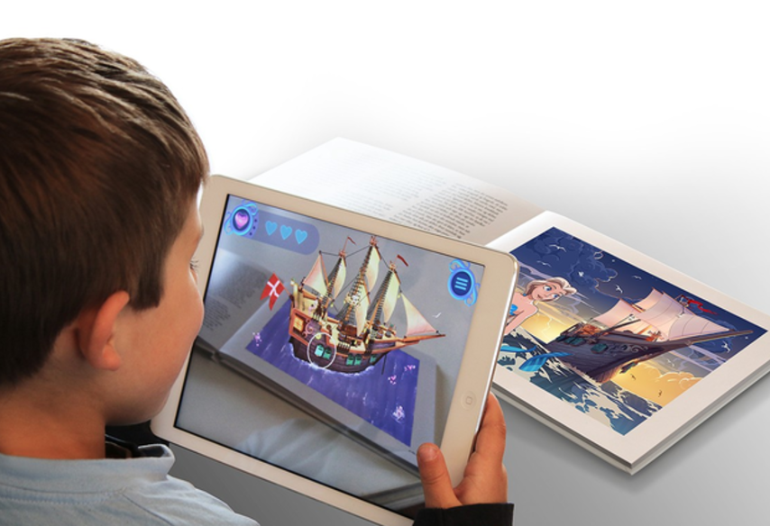

Slide 4

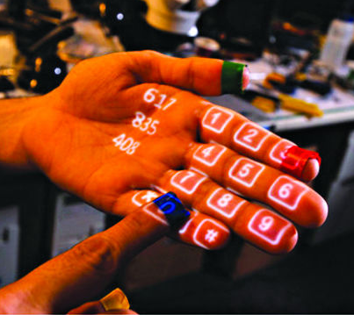
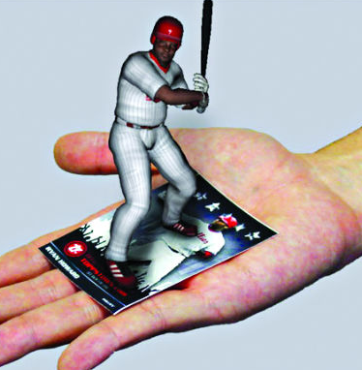
Literature Survey
Types of Augmented Reality
Projection Based AR
Recognition Based AR

Slide 5
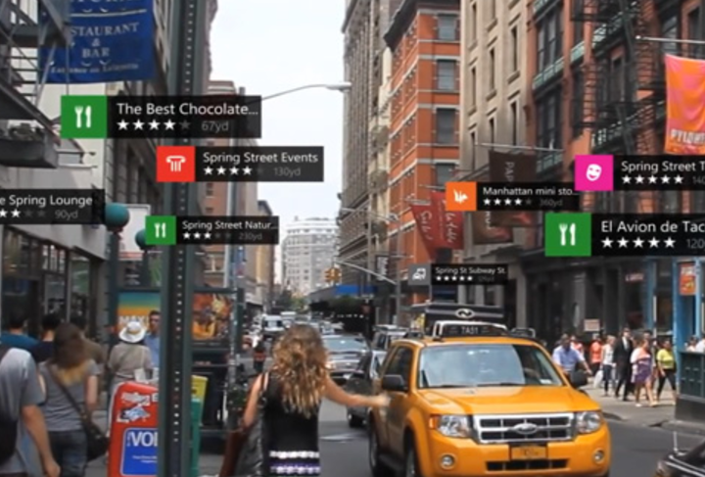
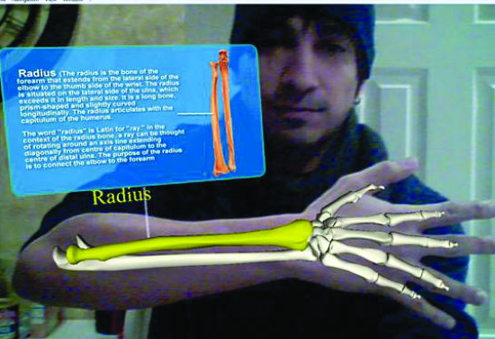
Location Based AR
Superimposition Based AR

Slide 6
Components of Augmented Reality-
Augmented reality systems are built upon on three major buildings blocks:
Tracking and Registration
Display technology
Real time rendering

Slide 7
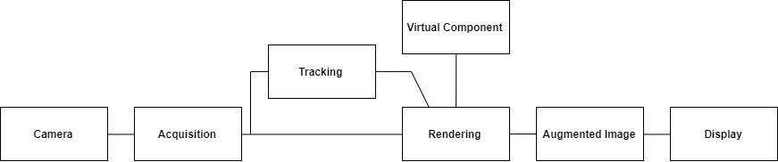
Architecture

Slide 8
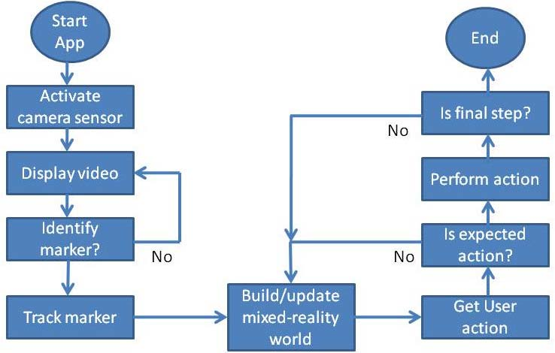
Flowchart

Slide 9

Objective
“Exploration” will help to inculcate learning and provide amazing experience to kids as well as adults. It will provide them a whole new look towards virtual and real world using Virtual and Augmented Reality.

Slide 10

Project Idea
The proposed project is an android application
based on Recognition based Augmented Reality.
The application “Exploration” will have various
functionalities like providing 3d view of different tourist places objects around you in the real world and also help students to view 3d complex structure in real world which would be difficult to imagine.

Slide 11

Hardware/Software Requirements
Unity3D (Personal edition)
Vuforia
C#
VR Headset
Smartphone with Gyroscope and Magnetometer
sensor

Slide 12

Project Outcomes
Outcome of the project will be an android application “Exploration”using Recognition based AR. Exploration app will be a marker based augmented reality using Android OS. In this project, we aim to investigate and apply various innovative applications of Virtual and Augmented Reality on real life surroundings and enhance the skills of individuals and society in an interactive manner.

Slide 13
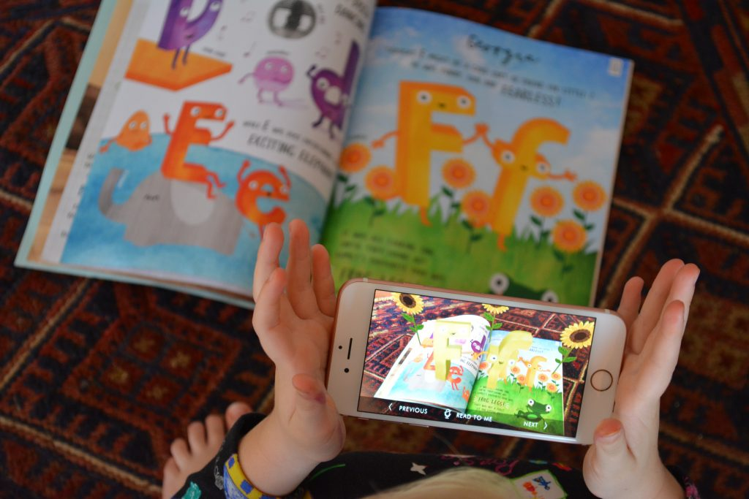

Expected Outcome

Slide 14
END

